Slide 1

Library Management System
A Python Based Desktop Application & Google Blogger Based E-Library
Presented By
Ahin Shubhra Halder
Avijit Halder
Abhisek Midya
Atish Sarkar
Supervised By
Prof. Aparna Kisku Hansda
Dept. of Computer Science,
Syamaprasad College

Slide 2


Domain Description
In the world of automation, Technologies reduce paper works in office.
In field of management by technology, here is our project about - Library Management System
Promises to reduce time, energy and paper works in library.

Slide 3
Motivation & Scope of the Work
To eliminate time taking paperwork.
To develop well organized system for book borrowing from library.
To minimize the task and effort being performed by librarian and borrower.
To create a more effective system.

Slide 4

Review
There was no authentication system (login page).
No admin panel & user panel was there.
No scope to add or modify member’s or book’s details.
No e-library page was attached to the system.
Lack of security was an issue.
Review is Based on :-
https://www.youtube.com/watch?v=GODYXAnBDvc

Slide 5
Problem Formulation
Book’s, User’s information maintained easily.
Ease of Borrowing or Returning Books.
Ease of Tracking all records.
Easily Manageable Library System for Administrator.
E-Library and E-mail reminder.

Slide 6

Design Description
ERD & DFD

Slide 7
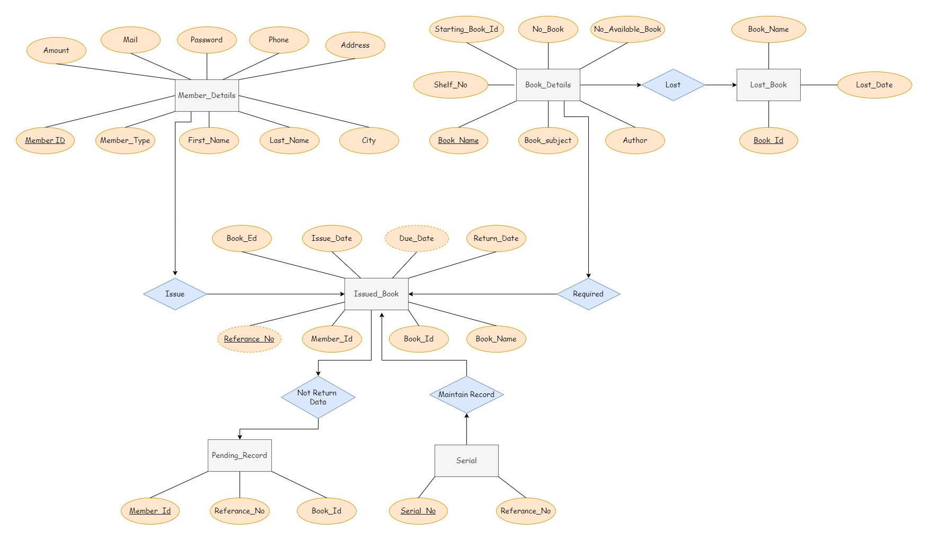
ER Diagram

Slide 8
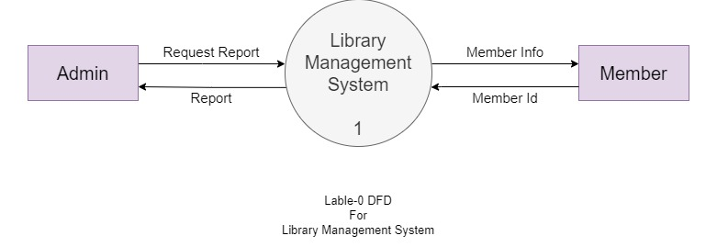
Data-Flow Diagram

Slide 9
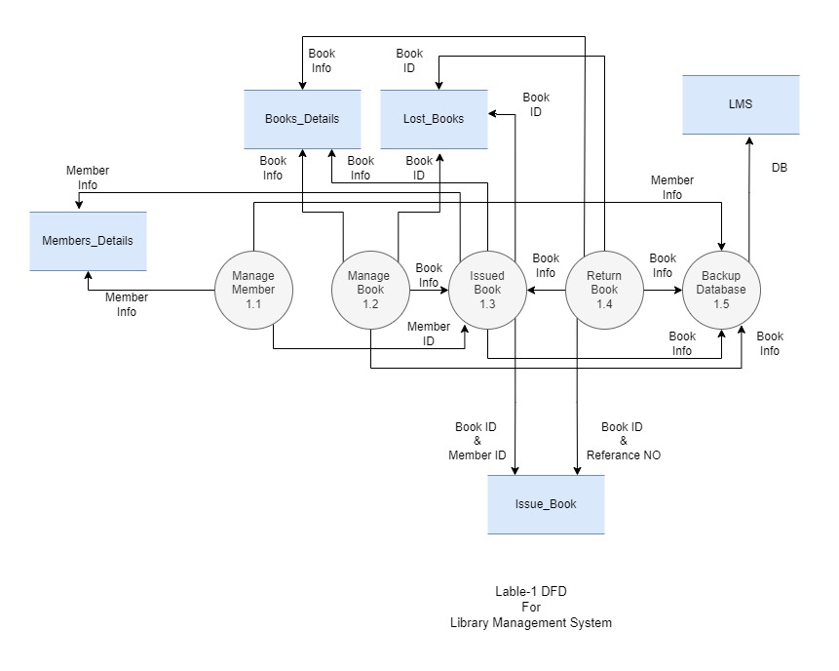

Slide 10
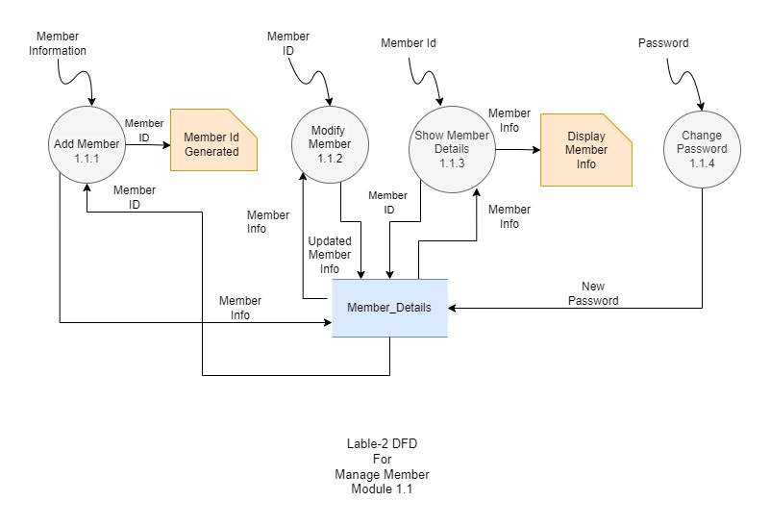

Slide 11
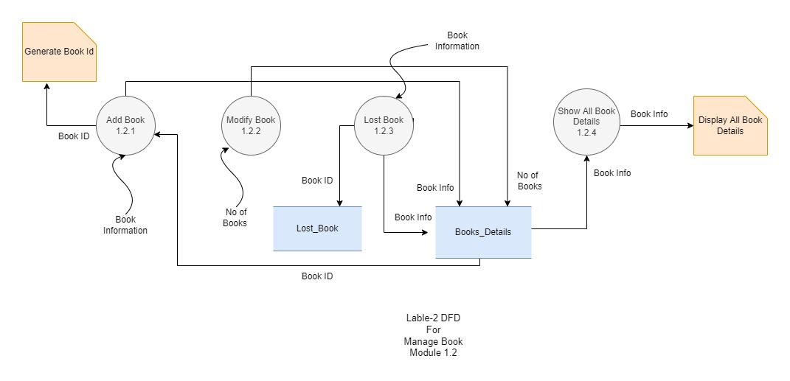

Slide 12
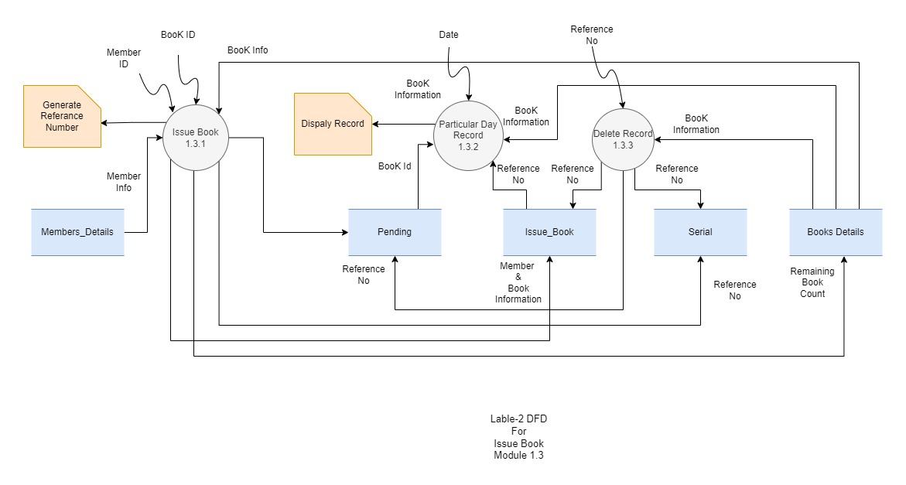

Slide 13
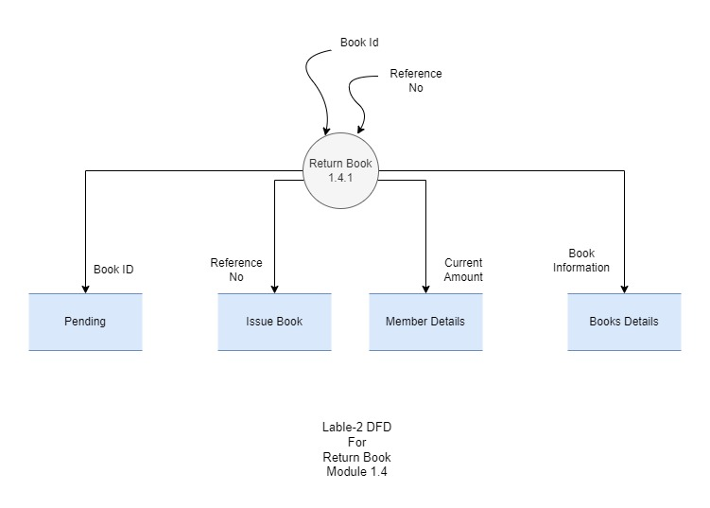

Slide 14
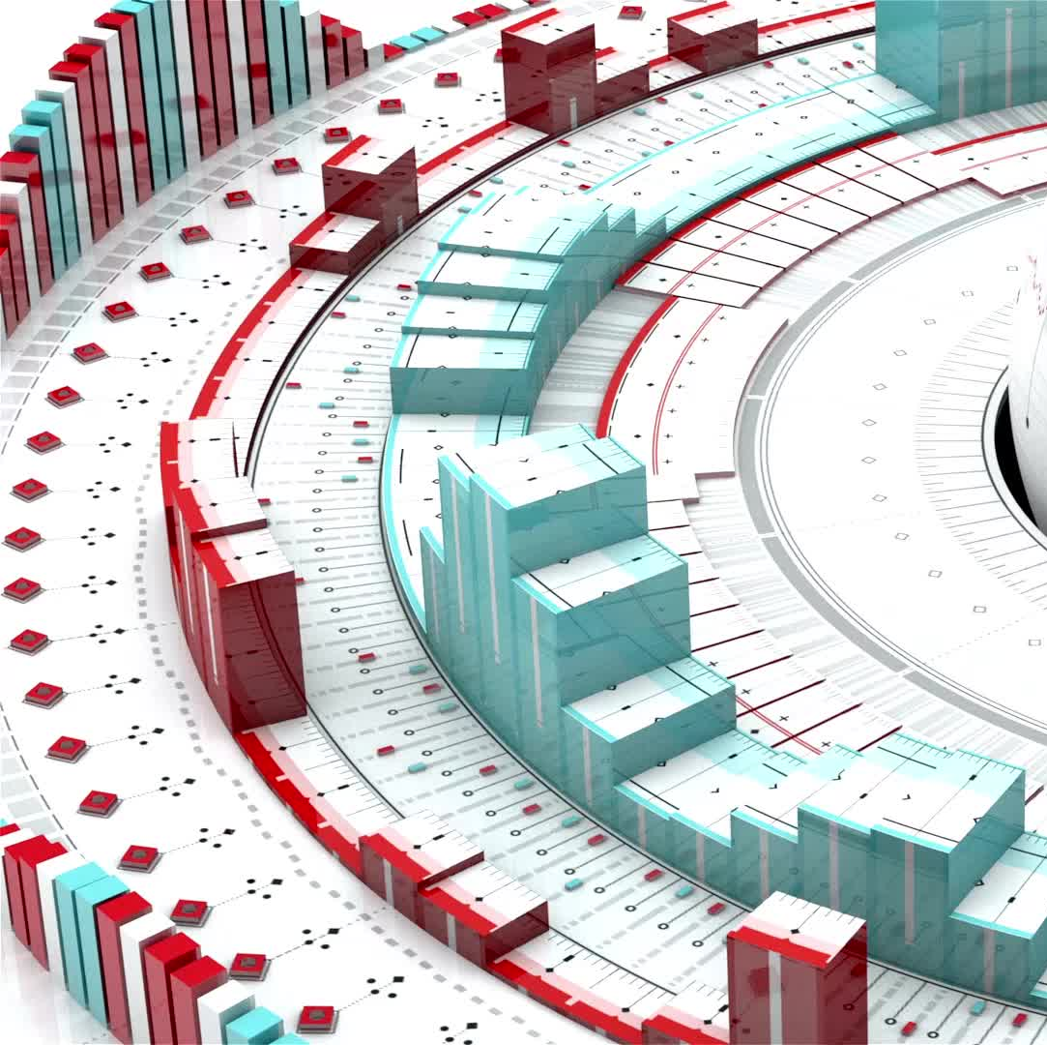
Implementation
Implementation is the stage where the theoretical design is turned into a working system.
The system can be implemented only after thorough testing is done and if it is found to work according to the specification.

Slide 15
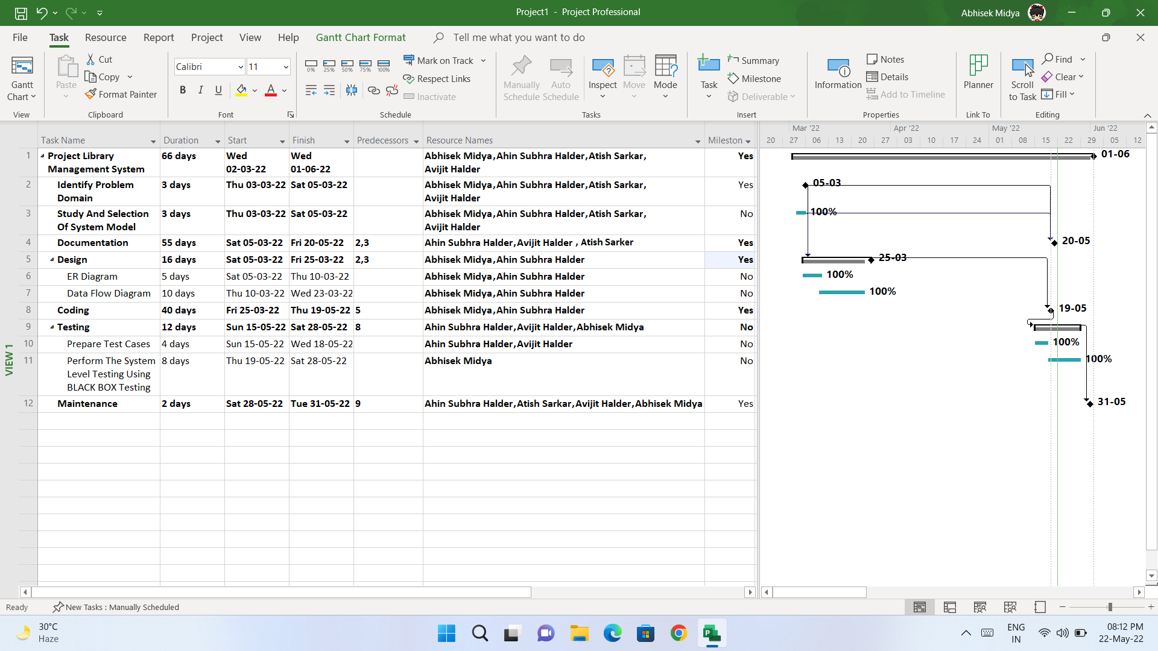
GNATT Chart

Slide 16
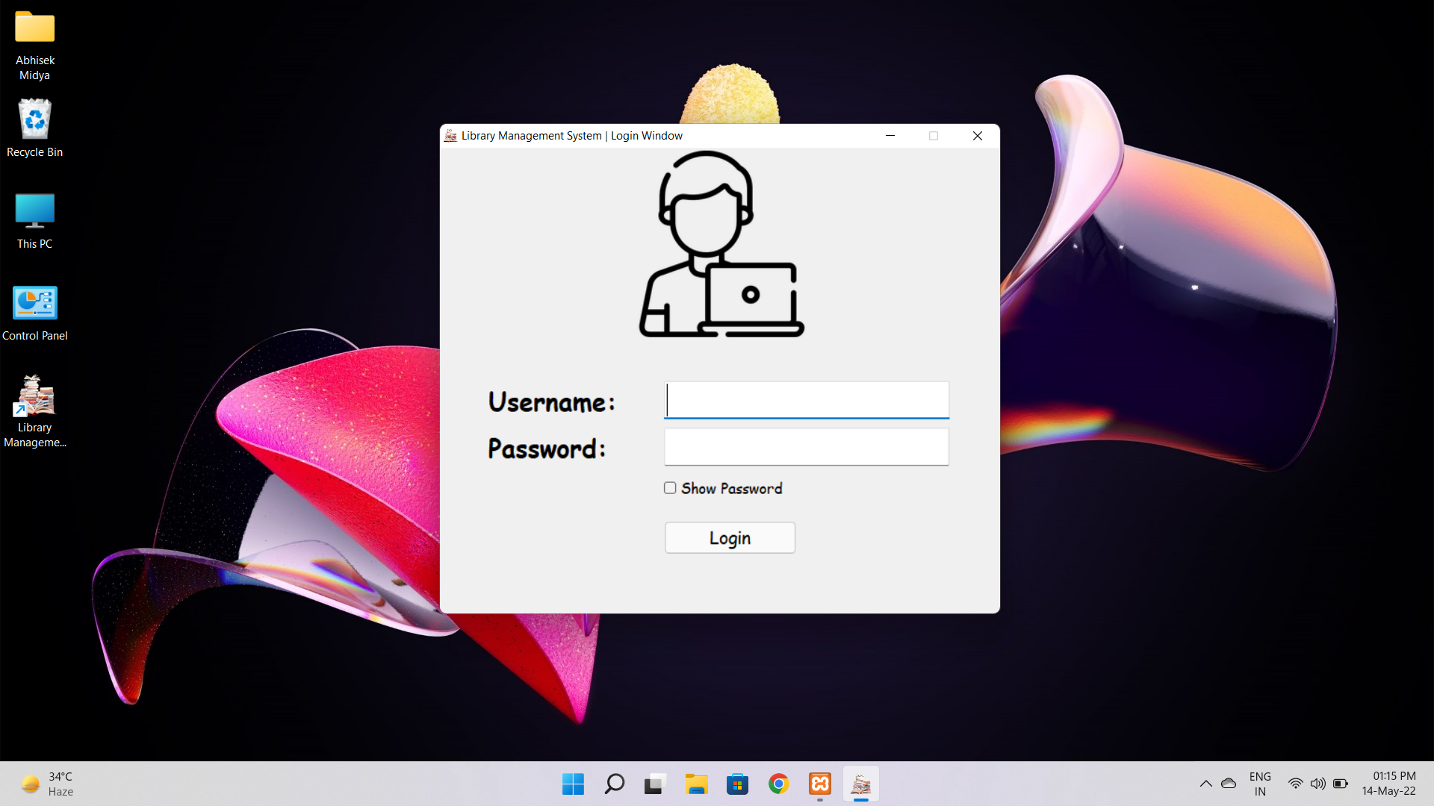
Login Page

Slide 17
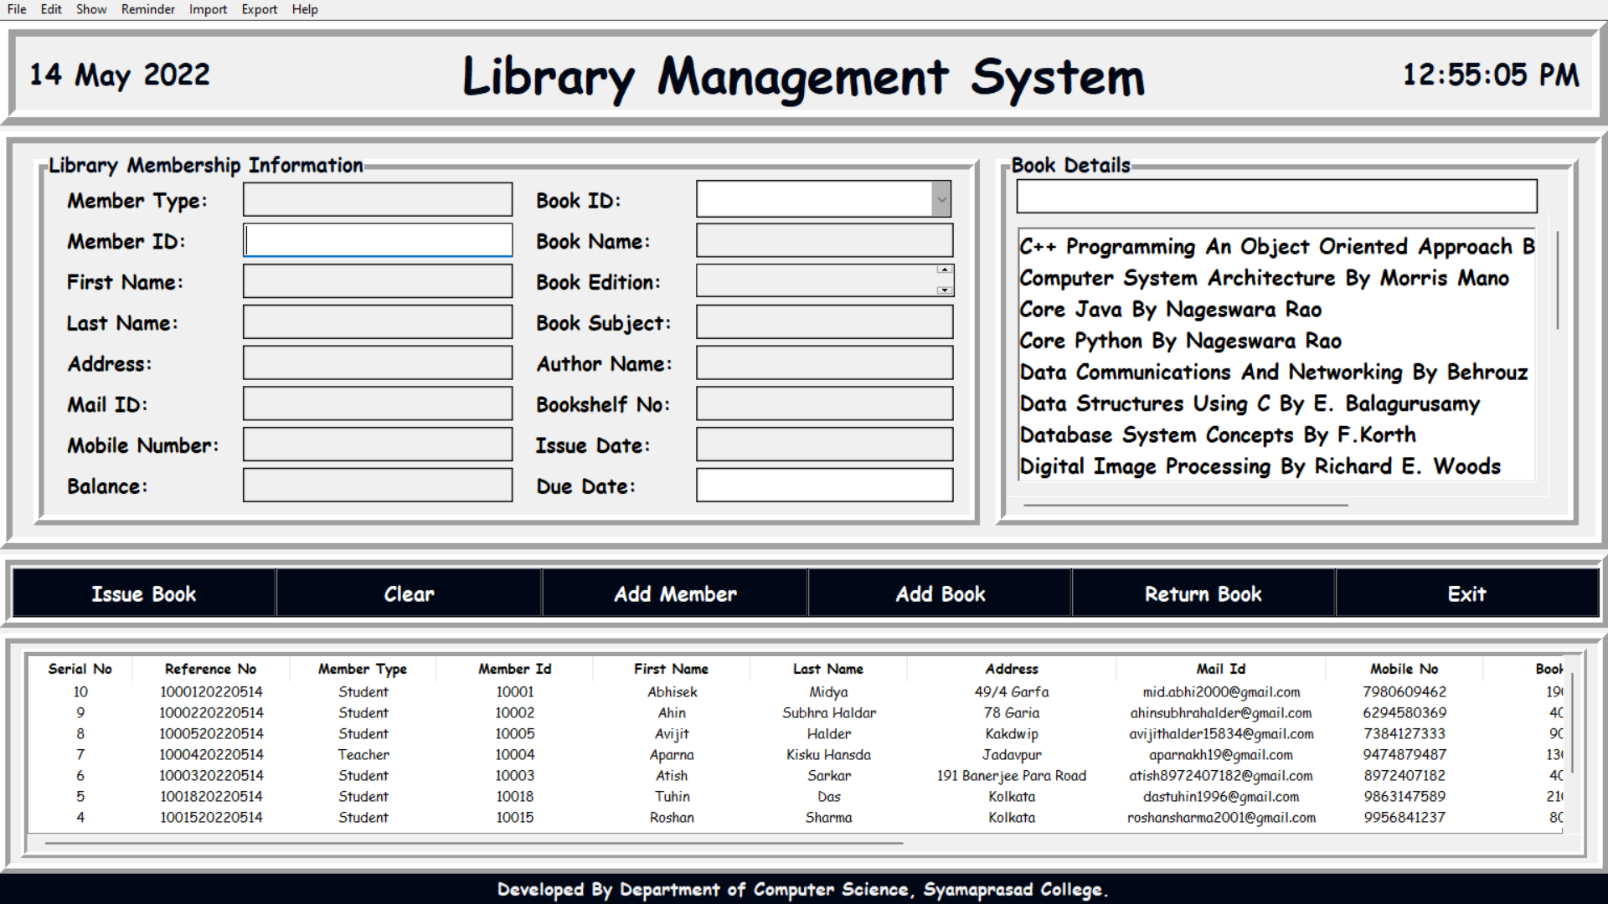
Admin Panel
Here, Admin can monitor and manage all the information.
All the available book related queries should be solved.
Admin can send email reminders to all the members, whose books are due within two days.

Slide 18
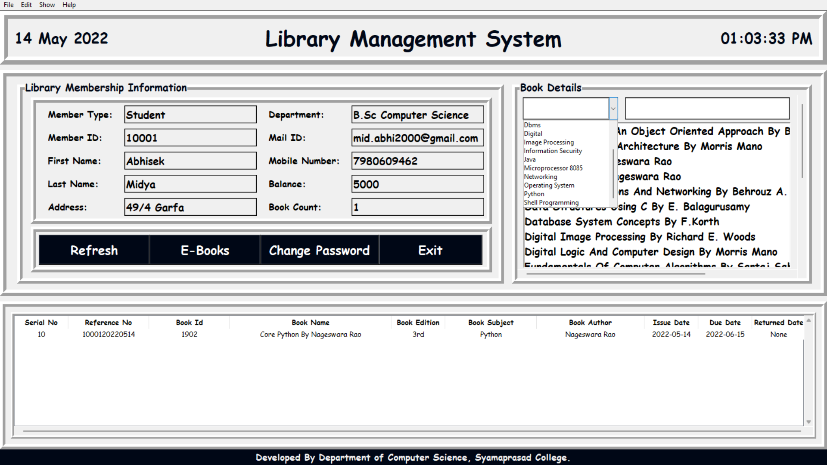
User Panel
Users can log in to the system by using their username and password, which have been sent to their email id at the time of registration.
Users can see all the book details by themself.
Users can go to the e-library directly from this panel.
Users can change their password.

Slide 19
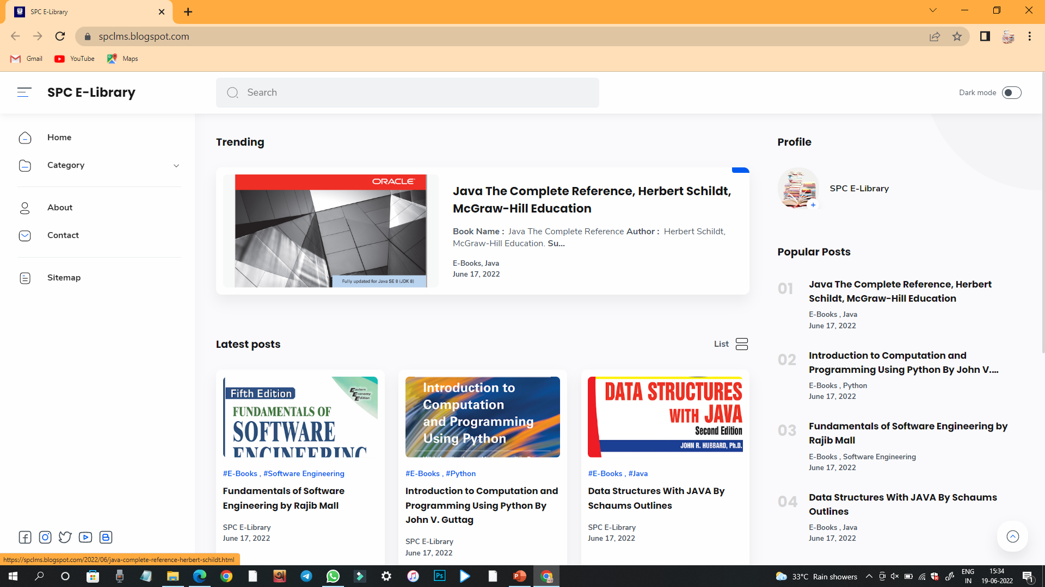
SPC E-Library
Our system supports members to get connected with books while required books are not available to borrow from library.

Slide 20

Result
We solved the problem that First Name & Last Name field should take only alphabet.
Book due date can’t be less than Issue book date if we enter due date less than issue date than system will give an error message.
If we enter wrong Username and Password then it will give an error message.
If we add previous recorded book into the database then the system will give an error message.

Slide 21
Conclusion
Library Management System of the entire system improves the efficiency.
It provides a friendly graphical user interface which proves to be better when compared to the existing system.
It gives appropriate access to the authorized users depending on their permissions.
It effectively overcomes the delay in communications.
Updating of information becomes so easier.
System security, data security and reliability are the striking features.
The System has adequate scope for modification in future if it is necessary.

Slide 22

Thank You

